Slide 1
Writing Cross-Platform PowerShell
Dave Carroll
@thedavecarroll

Slide 2
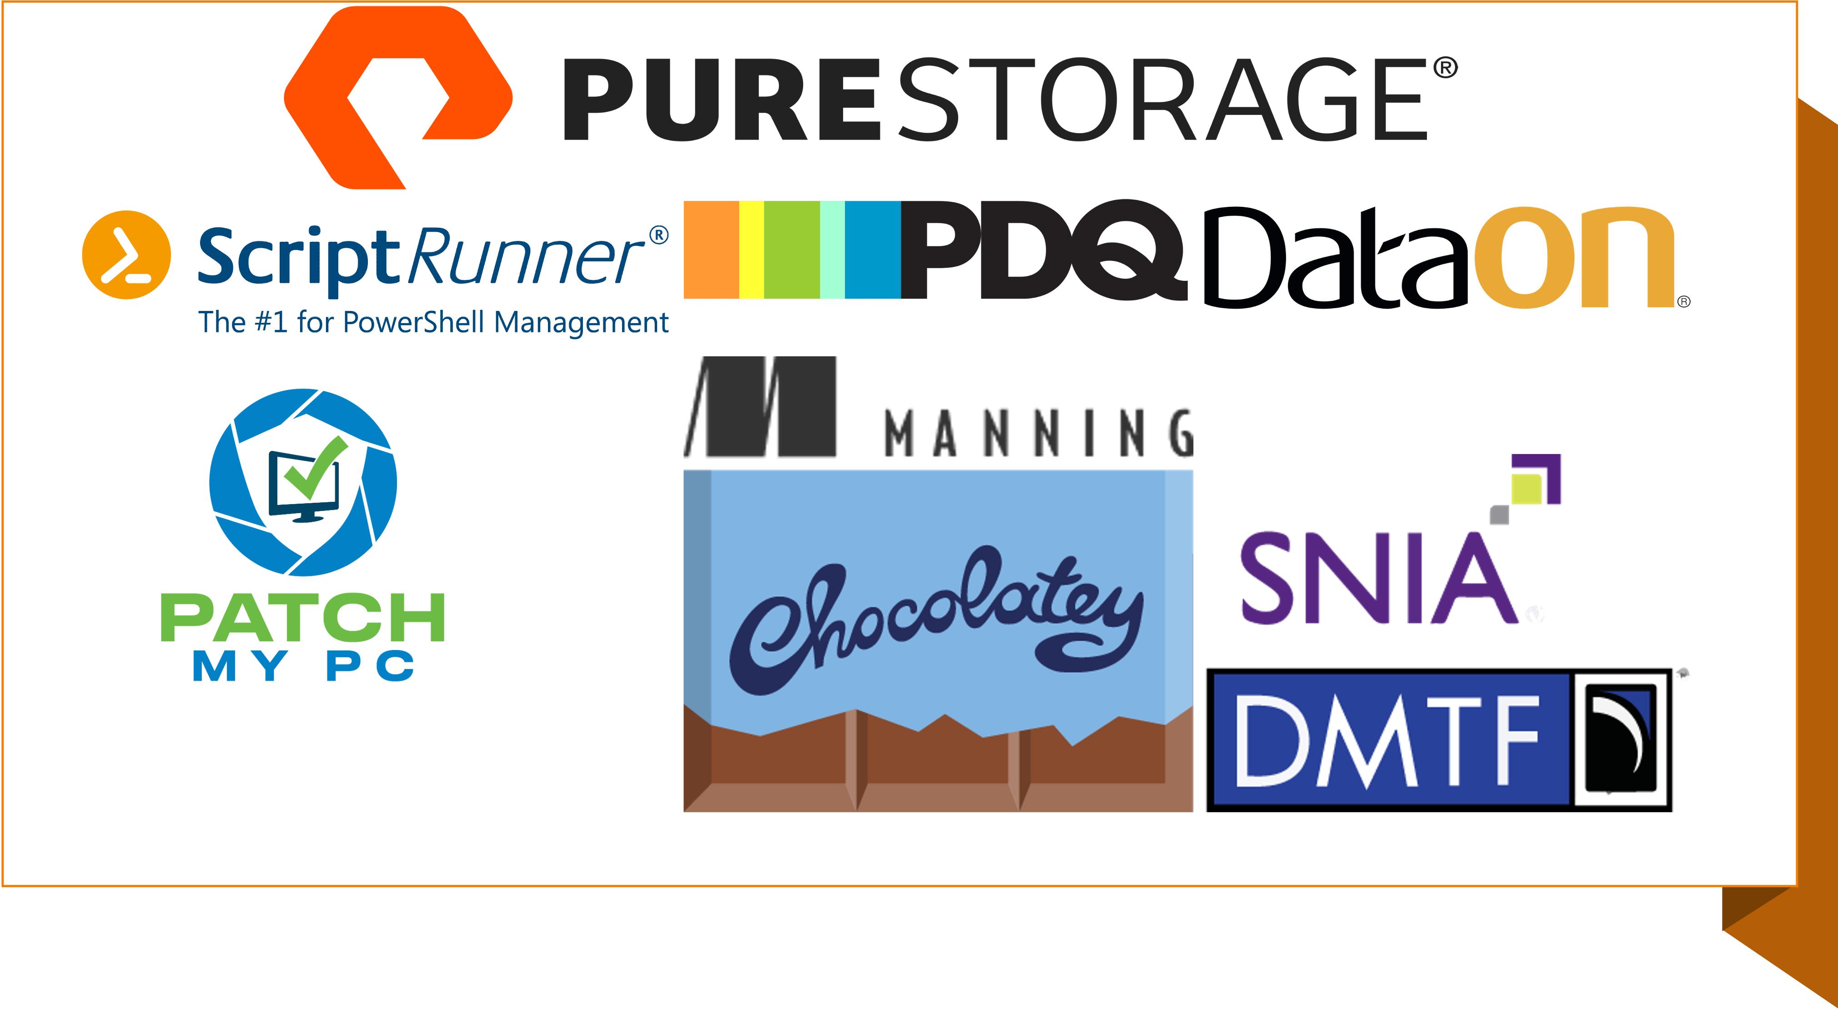
Sponsors

Slide 3
Get-SpeakerBio
DevOps Engineer/PowerShell Developer
Contributor to PowerShell Conference Book, volumes 2 and 3
Creator of PoShEvents, PoShGroupPolicy, and PSTemperature
PowerShell blogger for 6 years
Automating with PowerShell for 15 years
Solving IT problems for nearly 30 years

Slide 4
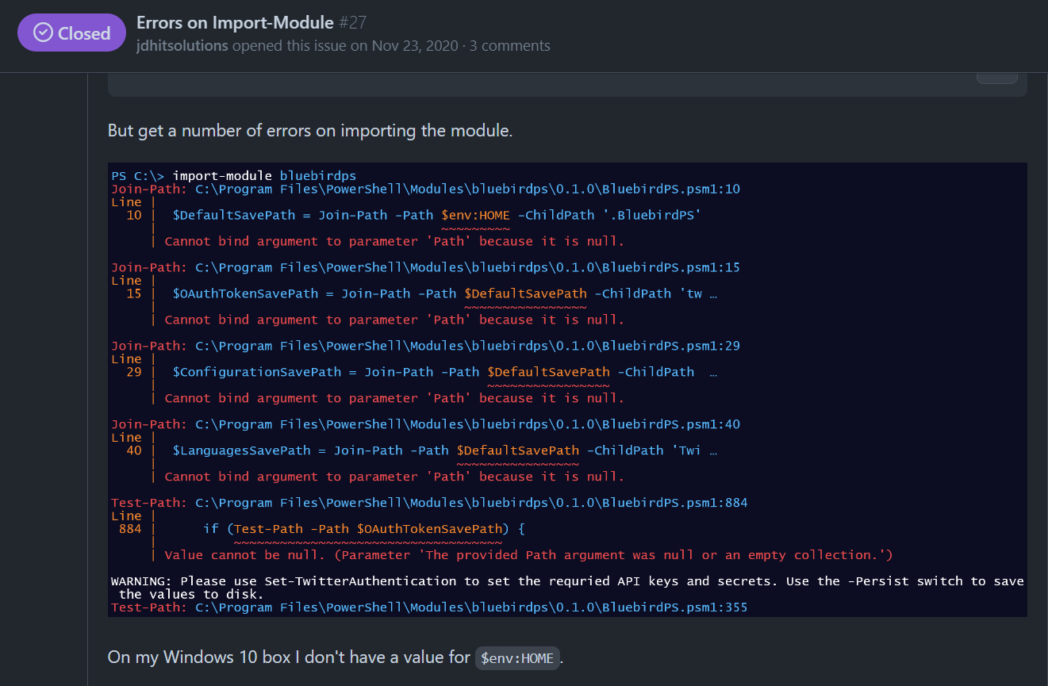
Not My Home
https://github.com/thedavecarroll/BluebirdPS/issues/27
Windows 10
$env:HOME
Vs
$HOME

Slide 5
Cross-Platform Support
PowerShell 7
Built on .NET Core/.NET 5+, it is inherently cross-platform, designed to run on Windows, Linux, and macOS with improved performance in many areas.
New operators and features like ternary operator (?:), null conditional operators (?. and ?[]), and pipeline parallelization with ForEach-Object ‑Parallel.
Windows PowerShell 5.1
Built on .NET Framework and limited to Windows OS.

Slide 6
Compatibility
PowerShell 7:
Offers broader compatibility with existing Windows PowerShell modules through the Enable‑ExperimentalFeature cmdlet and the ‑UseWindowsPowerShell switch in the Import‑Module cmdlet.
Not all Windows-specific modules are available or fully functional on Linux and macOS, and vice versa, due to the underlying platform differences.
Windows PowerShell 5.1:
Has access to all modules designed for the .NET Framework, but these may not be compatible with PowerShell 7 without modifications, particularly for non‑Windows platforms.

Slide 7

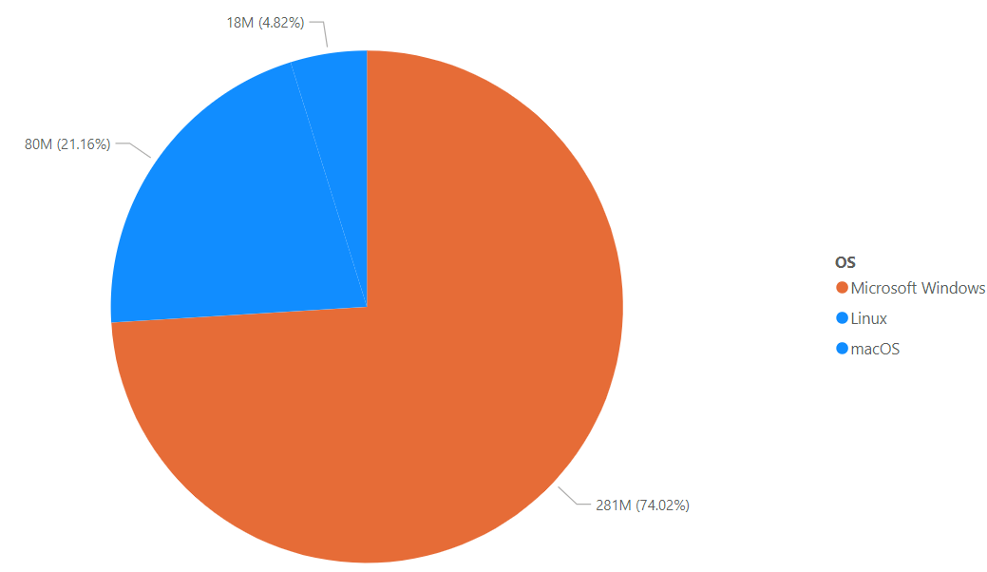
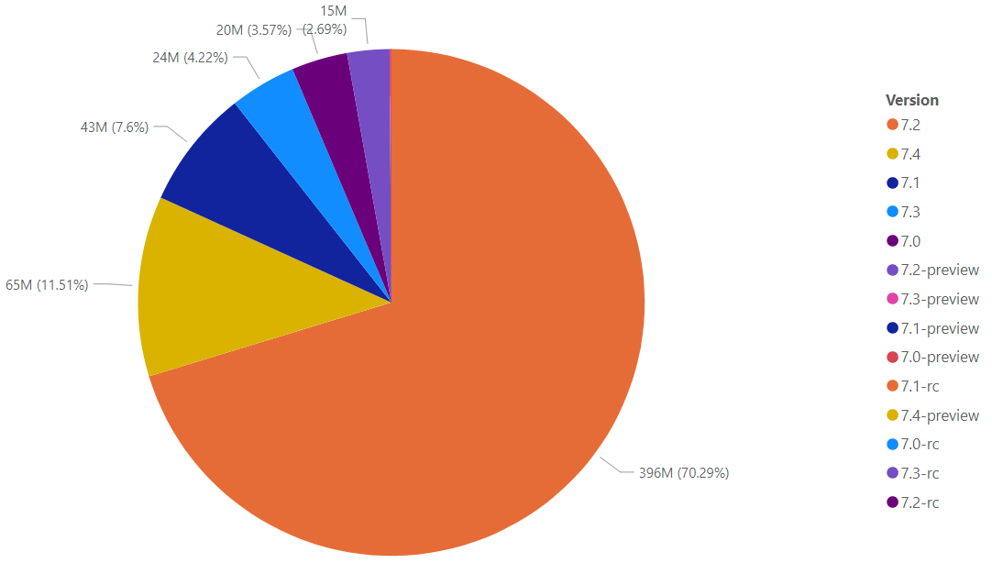
PowerShell 7 Usage
Nodes by Operating System
90 days
Microsoft Windows – 281M
Linux – 80M
macOS – 18M
Nodes by PowerShell Version
90 days
7.4 – 65M
7.2 – 396M
7.1 – 43M

Slide 8

Install PowerShell 7
Windows
MSI, ZIP, .NET Global Tool, Winget, PSReleaseTools
Linux
apt-get, snap, apk/curl
macOS
brew, .NET Global Tool, curl

Slide 9

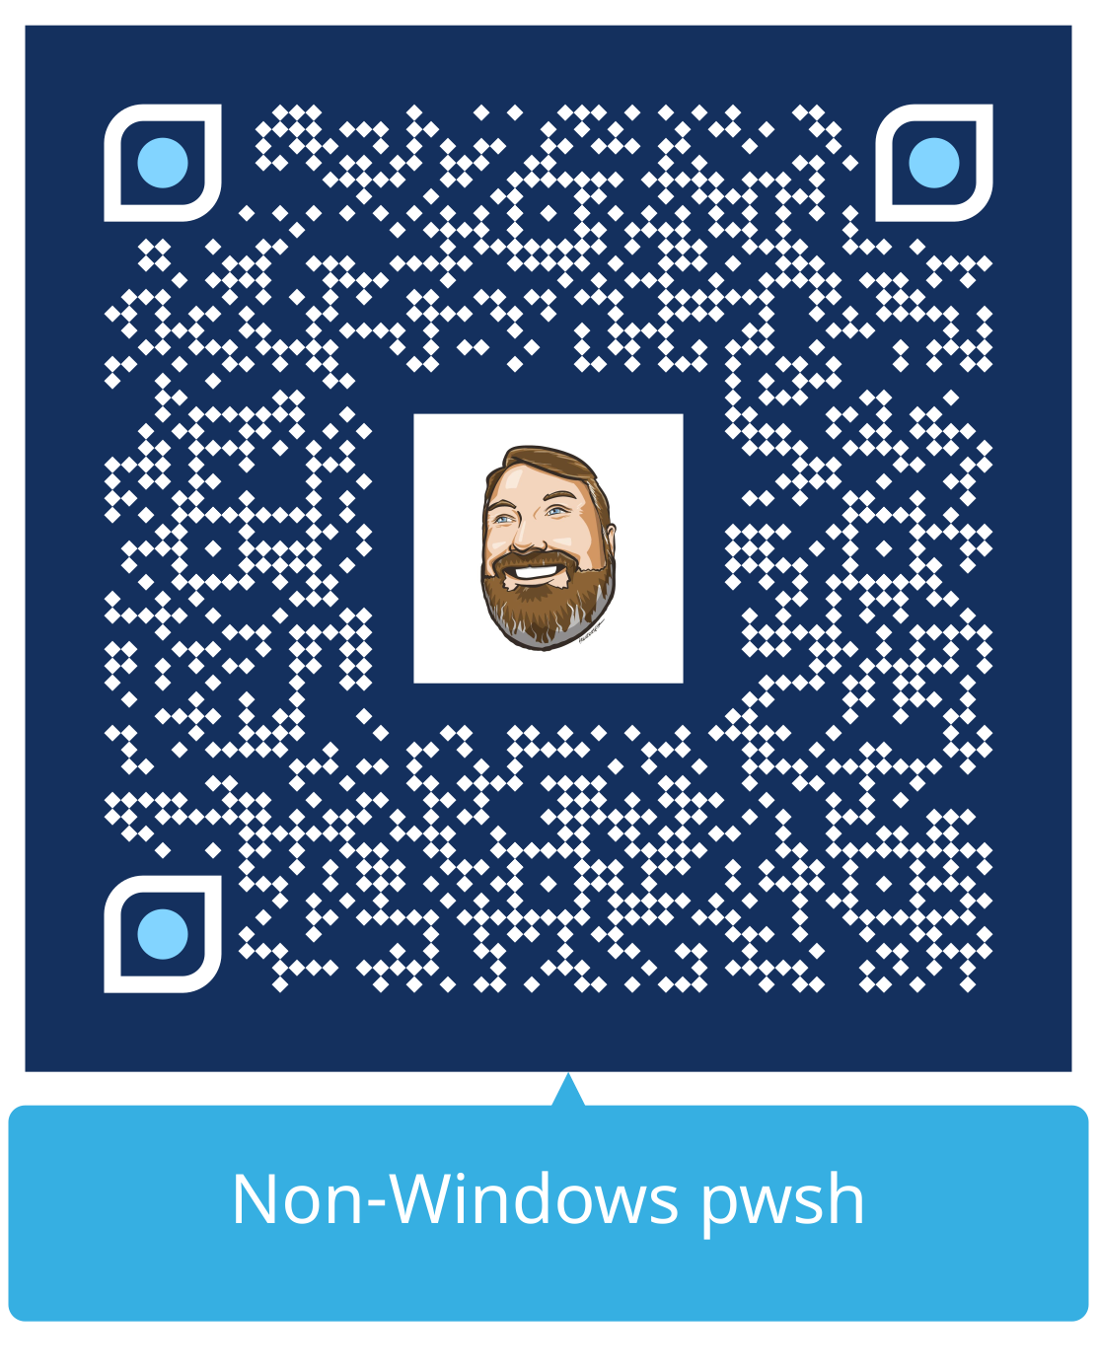
Compare-Object

Slide 10
Unique-*nix
#! - shebang or magic number
Required for PowerShell script execution without .ps1 extension
Creates new process, can’t share script scoped variables and objects
Convenience aliases removed
Another reason to use full commands in scripts
A Case for Case Sensitivity
Filenames – required, but not via tab completion
Get-Help and Import-Module – Case insensitive

Slide 11


Thank You
Yes!
It’s DEMO TIME!

Slide 12
Other Presentations with Linux
Rocking Docker with PowerShell Tuesday 3:15 pm → 45 min
James Brundage
Using PowerShell to be a Linux Admin Wednesday 2:00 pm → 45 min
Steven Judd
What's new with SSH in Azure and Windows Wednesday 4:15 pm → 45 min
Sydney Smith
Danny Maertens
WinRM vs. OpenSSH: A Showdown for PowerShell Remoting Thursday 11:00 am → 45 min
Paul Broadwith

Slide 13

THANK YOU
Please review this session

